Slide 1
Introduction and Review of Software Testing
Course Code: CIT-5202
Title: Software Testing & Quality Assurance
Course Teacher:
Md. Atikqur Rahaman
Dept. of CSIT, Faculty of CSE,
PSTU, Bangladesh.

Slide 2
Objective
The objective of this presentation is to show the
How to define Software Testing Principles
What are the types of Software Tests
What is Test Planning
Test Execution and Reporting
Real-Time Testing

Slide 3
How to define Software Testing Principles
Testing
The execution of a program to find its faults
Verification
The process of proving the programs correctness.
Validation
The process of finding errors by executing the program in a real environment
Debugging
Diagnosing the error and correct it
Notes:
Software testing is defined as the execution of a program to find its faults. While more time typically is spent on testing than in any other phase of software development, there is considerable confusion about its purpose. Many software professionals, for example, believe that tests are run to show that the program works rather than to learn about its faults.
Myers has provided some useful testing definitions:
Testing
The process of executing a program (or part of a program) with the intention of finding errors.
Verification
An attempt to find errors by executing a program in a test or simulated environment (it is now preferable to view verification as the process of proving the program’s correctness)
Validation
An attempt to find errors by executing a program in a real environment.
Debugging
Diagnosing the precise nature of a known error and then correcting it (debugging is a correction and not a testing activity)
Verification and validation are sometimes confused. They are, in fact, different activities. The difference between them is succinctly summarized by Boehm:
‘Validation: Are we building the right product?’
‘Verification: Are we building the product right?’

Slide 4
Software Testing Principles
The (07) seven principles of testing
Testing shows the presence of defects, not their absence
Exhaustive testing is impossible
Early testing saves time and money.
Defects cluster together.
Beware of the pesticide paradox
Testing is context dependent.
Absence-of-errors is a fallacy.
Notes:
A common view of testing is that all untested code has a roughly equal probability of containing defects. DeMarco asserts that the incidence of defects in untested codes varies widely and that no amount of testing can remove more than 50 percent of them. However, there is data that shows that properly run unit tests are potentially capable of detecting as many as 70 percent of the defects in a program. The objective should therefore be to remove as many as defects as possible before test since the quality improvement potential of testing is limited.
An examination of even relatively simple programs demonstrates that exhaustive testing is generally impossible. If a program were to analyze a string of only ten alphabetic characters, there would be 26¹⁰ possible combinations. Testing one condition every microsecond would take four and a half million years. Thus test design reduces to a small subset of conditions that will reveal the characteristics of the program.

Slide 5
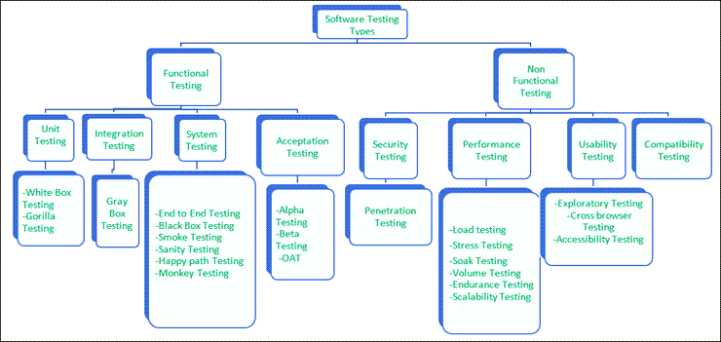
Types of Software Tests

Slide 6
List of Software Tests
Functional testing
Unit Testing (White Box)
Integration Testing
Function Testing (Black Box)
Regression Testing
System Test
Acceptance and Installation Tests
Non-Functional testing:
Security testing
Performance testing
Usability testing
Compatibility testing

Slide 7
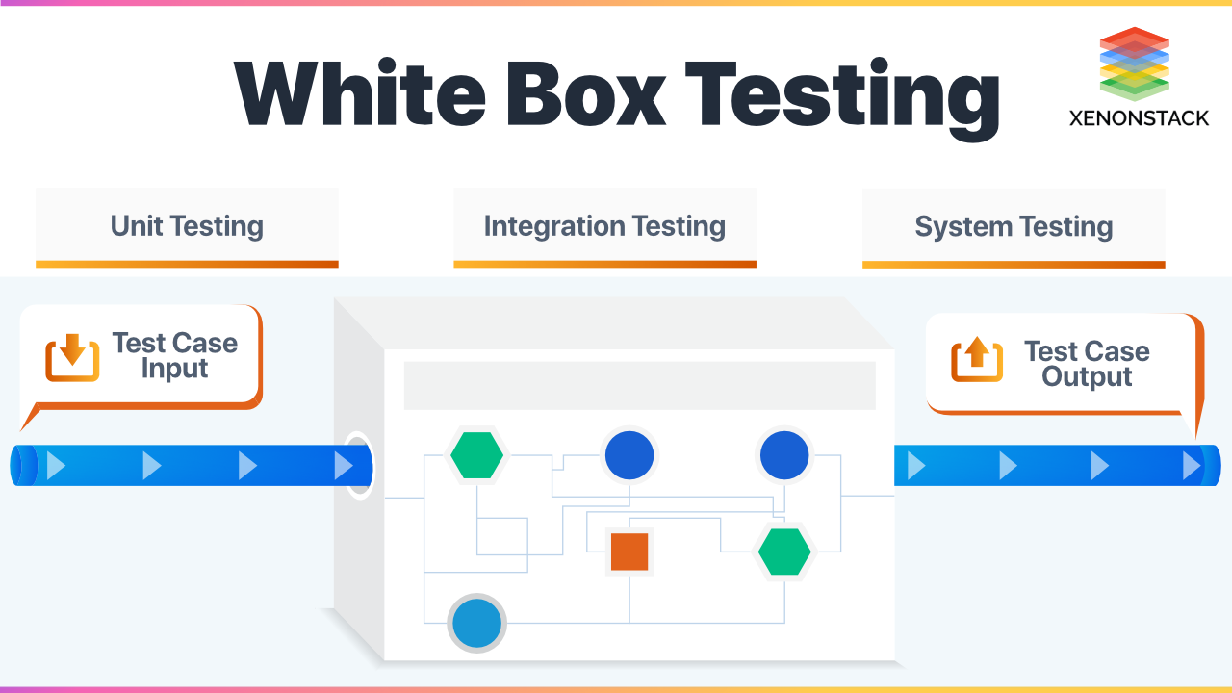
Unit Testing (White Box)
White box testing is an approach that allows testers to inspect and verify the inner workings of a software system—its code, infrastructure, and integrations with external systems.
Individual components are tested.
It is a path test.
To focus on a relatively small segment of code and aim to exercise a high percentage of the internal path

Slide 8
Unit Testing (White Box)
Benefits of Unit Testing
Improve Quality and Performance. Unit testing can improve the quality of your codebase, making it more maintainable and less error-prone.
Allows for Documentation.
Find Bugs.
Makes Debugging Easier.
Reduces Software Complexity.
Notes:
When unit tests are done on a white box basis, they are essentially path test. The idea is to focus on a relatively small segment of code and aim to exercise a high percentage of the internal paths. The simplest approach is to ensure that every statement is exercised at least once. A more stringent criterion is to require coverage of every path within a program.
One disadvantage of white box testing is that the tester may be biased by previous experience. The tests are often designed by the programmers who produced the code since they may be the only ones who understand it. Unfortunately, those who created the programs’ faults are least likely to recognize them. Even though all the paths and variable of the program have gone through by the testing program, it could not guarantee all possible values of the variables have been tested.
While its disadvantages are significant, white box testing generally has the highest error yield of all testing techniques.

Slide 9
Unit Testing (White Box)
Disadvantages of Unit Testing
With UT, you have to increase the amount of code that needs to be written. You usually have to write one or more unit tests depending on how complex things are.
Unit tests are problematic when testing your user interface (UI). They are good for when you need to test business logic implementation but not great for UI.
In comparison to those who say UT improves code, others say it makes it worse and ends up adding indirection that is pointless. Changing code and adding new code can mean navigational issues and more time spent before integration testing is even started.
UT cannot and will not catch all errors in a program. There is no way it can test every execution path or find integration errors and full system issues.
Unit tests have to be realistic. You want the unit you’re testing to act as it will as part of the full system. If this doesn’t happen, the test value and accuracy are compromised.

Slide 10
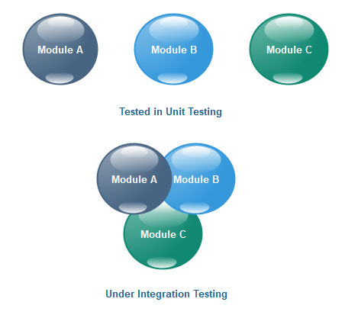
Integration Testing
Integration testing -- also known as integration and testing (I&T) -- is a type of software testing in which the different units, modules or components of a software application are tested as a combined entity.
For example the fuel system may be tested in collaboration with an exhaust system, and later, these two module's working is tested in collaboration with the working of an engine. Now, this is integration testing.

Slide 11
Integration Testing
Top-down Integration Test
Bottom-up Integration Test
Mixed/sandwich integration testing.
Big-bang integration testing.
Notes:
This phase involves testing of modules which have been integrated in sub-system. A module is a collection of dependent components such as object class, and abstract data type of some looser collection of procedures and functions.
On very large system it is often wise to do integration testing in several steps. Such systems generally have several relatively large components that can be built and integrated separately before combination into a full system.
Integration Testing is divided into Top-down Integration Test and Bottom-up Integration Test.

Slide 12
Integration Testing
Top-down Integration Test
The control program is tested first. Modules are integrated one at a time. Emphasize on interface testing
Advantages: No test drivers needed
Interface errors are discovered early
Modular features aid debugging
Disadvantages: Test stubs are needed
Errors in critical modules at low levels are found late.
Notes:
Top-down Integration Test starts with the most abstract components and works downwards.
It tests the high levels of a system before testing its detailed components. The program is represented as a single abstract component with sub-components represented by stubs.
Top-down Integration Test is essentially a prototyping philosophy. The initial tests establish a basic system skeleton from the top and each new module adds capability. The problem is that functions of the lower-level modules that are not initially present must by simulated by program stubs. While producing such stubs may at first seem easy, it would be more difficult as more stub add on it. It may be difficult or impossible to test certain logical conditions such as error handling.

Slide 13
Top-down Testing
T1
T1
A
A
T2
T2
B
B
T3
T3
C
T4
Notes:
Test T1, T2, T3 are first run on a system composed of module A and module B. Module C is integrated and test T1 and T2 are repeated to ensure that there have not been unexpected interactions with A and B. Test T4 is also run on the system.

Slide 14
Integration Testing
Bottom-up Integration Test
Allow early testing aimed at proving feasibility
Emphasize on module functionality and performance
Advantages: No test stubs are needed
Errors in critical modules are found early
Disadvantages: Test drivers are needed
Interface errors are discovered late

Slide 15
Bottom-up testing
Test
Drivers
Test
Drivers
Test
Drivers
Level N
Level N
Level N
Test
Drivers
Test
Drivers
Level N-1
Level N-1
Notes:
Bottom-up testing is the converse of top-down testing. It involves testing the modules at the lower levels in the hierarchy, and then working up the hierarchy of modules until the final module is tested.

Slide 16

Big-bang integration testing
Big bang integration testing is a testing approach where all components or modules are integrated and tested as a single unit. This is done after all modules have been completed and before any system-level testing is performed.

Slide 17
Big-bang integration testing
Advantage of Big Bang Integration:
Big bang integration testing allows for testing of complex interactions between components. This is beneficial as it allows for the identification of errors that may not be detected by other testing methods
Disadvantages of Big Bang Integration:
In general it is very time consuming. It can be difficult to identify and fix errors that are discovered late in the testing process.

Slide 18
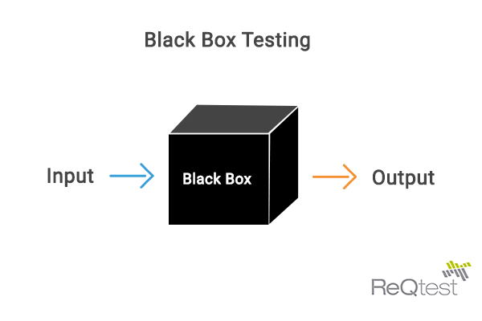
System/Function Testing (Black Box)
Black box testing is a software testing methodology in which the tester analyzes the functionality of an application without a thorough knowledge of its internal design.
Example:
we all have tried Black Box testing in our lives. For example, while pressing the start button of a bike, we expect it to start without getting into its inner working mechanism. In other words, it focuses on the functionality of the software without any need for coding knowledge
Notes:
Since exhaustive black box testing is generally impossible, these test should be viewed as statistical sampling; when errors are found, a closer examination is required. Functional testing stars by examining the functions the program is to perform and devising a sequence of inputs to test them.

Slide 19
System/Function Testing (Black Box)
Advantage:
Well suited and efficient for large code segments.
Code access is not required.
Clearly separates user's perspective from the developer's perspective through visibly defined roles
Large numbers of moderately skilled testers can test the application with no knowledge of implementation, programming language, or operating systems.
Disadvantage:
Limited coverage, since only a selected number of test scenarios is actually performed.
Inefficient testing, due to the fact that the tester only has limited knowledge about an application.
Blind coverage
The test cases are difficult to design.
Notes:
Since exhaustive black box testing is generally impossible, these test should be viewed as statistical sampling; when errors are found, a closer examination is required. Functional testing stars by examining the functions the program is to perform and devising a sequence of inputs to test them.

Slide 20
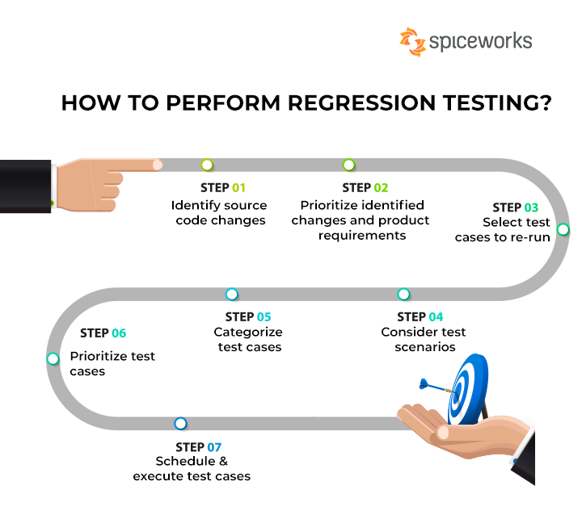
Regression Testing
Regression testing is testing existing software applications to make sure that a change or addition hasn't broken any existing functionality.
Example, these code changes could include adding new features, fixing bugs, or updating a current feature.

Slide 21
Acceptance Testing
Acceptance testing is a quality assurance (QA) process that determines to what degree an application meets end users' approval. Depending on the organization, acceptance testing might take the form of beta testing, application testing, field testing or end-user testing.
Example:
Alpha and beta testing are examples of acceptance testing. Alpha tests are internal and aim to spot any glaring defects, while beta testing is an external pilot-test of a product before it goes into commercial production.
Notes:
The progressive phase introduces and tests new functions, uncovering problems in the newly added or modified modules and in their interfaces with the previously integrated modules. The regressive phase concerns the effect of the newly introduced changes on all the previously integrated code. Problems arise when errors made in incorporating new functions affect previously tested functions.
The basic regression testing approach is to incorporate selected test cases into a regression test bucket that is run periodically in an attempt to detect regression problems. Usually the full bucket is run only occasionally, but the subset is run against every spin. The spin subset should include all the test cases for any recently integrated functions and a selected sample from the full regression bucket.

Slide 22
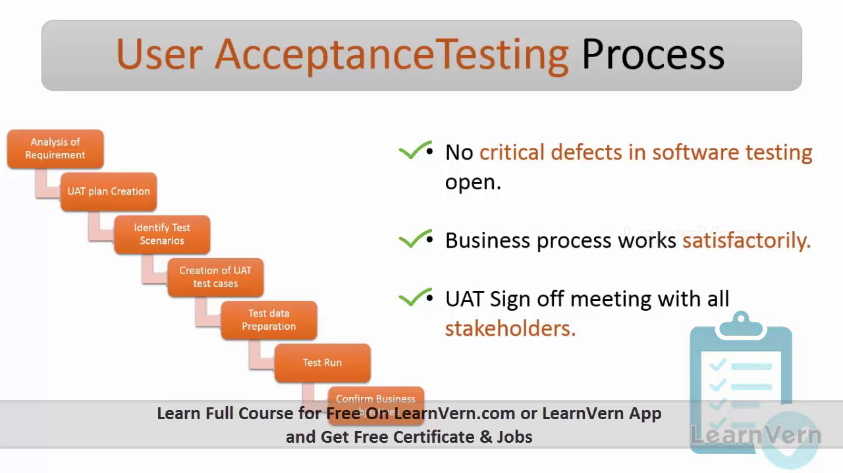
Acceptance Testing
Notes:
The progressive phase introduces and tests new functions, uncovering problems in the newly added or modified modules and in their interfaces with the previously integrated modules. The regressive phase concerns the effect of the newly introduced changes on all the previously integrated code. Problems arise when errors made in incorporating new functions affect previously tested functions.
The basic regression testing approach is to incorporate selected test cases into a regression test bucket that is run periodically in an attempt to detect regression problems. Usually the full bucket is run only occasionally, but the subset is run against every spin. The spin subset should include all the test cases for any recently integrated functions and a selected sample from the full regression bucket.

Slide 23
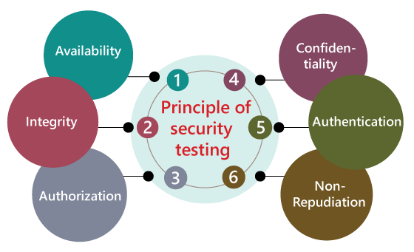
Security Testing
Software security testing is a software testing process that ensures the software is free of any potential vulnerabilities or weaknesses, risks, or threats so that the software might not harm the user system and data.
Notes:
The progressive phase introduces and tests new functions, uncovering problems in the newly added or modified modules and in their interfaces with the previously integrated modules. The regressive phase concerns the effect of the newly introduced changes on all the previously integrated code. Problems arise when errors made in incorporating new functions affect previously tested functions.
The basic regression testing approach is to incorporate selected test cases into a regression test bucket that is run periodically in an attempt to detect regression problems. Usually the full bucket is run only occasionally, but the subset is run against every spin. The spin subset should include all the test cases for any recently integrated functions and a selected sample from the full regression bucket.

Slide 24

Security Testing
6 Principle of Security testing
1. Availability:-In this, the data must be retained by an official person, and they also guarantee that the data and statement services will be ready to use whenever we need it.
2. Integrity:-In this, we will secure those data which have been changed by the unofficial person. The primary objective of integrity is to permit the receiver to control the data that is given by the system
3. Authorization:-
4. Confidentiality:-It is a security process that protracts the leak of the data from the outsider's
5. Authentication:-The authentication process comprises confirming the individuality of a person
6. Non-repudiation:-The non-repudiation is used to ensure that a conveyed message has been sent and received by the person who claims to have sent and received the message.
Notes:
The progressive phase introduces and tests new functions, uncovering problems in the newly added or modified modules and in their interfaces with the previously integrated modules. The regressive phase concerns the effect of the newly introduced changes on all the previously integrated code. Problems arise when errors made in incorporating new functions affect previously tested functions.
The basic regression testing approach is to incorporate selected test cases into a regression test bucket that is run periodically in an attempt to detect regression problems. Usually the full bucket is run only occasionally, but the subset is run against every spin. The spin subset should include all the test cases for any recently integrated functions and a selected sample from the full regression bucket.

Slide 25
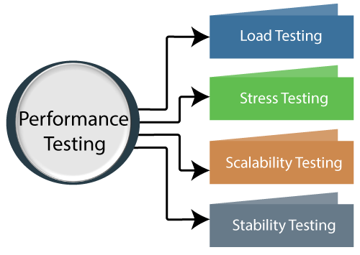
Performance Testing
Performance testing is a non-functional software testing technique that determines how the stability, speed, scalability, and responsiveness of an application holds up under a given workload
Notes:
The progressive phase introduces and tests new functions, uncovering problems in the newly added or modified modules and in their interfaces with the previously integrated modules. The regressive phase concerns the effect of the newly introduced changes on all the previously integrated code. Problems arise when errors made in incorporating new functions affect previously tested functions.
The basic regression testing approach is to incorporate selected test cases into a regression test bucket that is run periodically in an attempt to detect regression problems. Usually the full bucket is run only occasionally, but the subset is run against every spin. The spin subset should include all the test cases for any recently integrated functions and a selected sample from the full regression bucket.

Slide 26
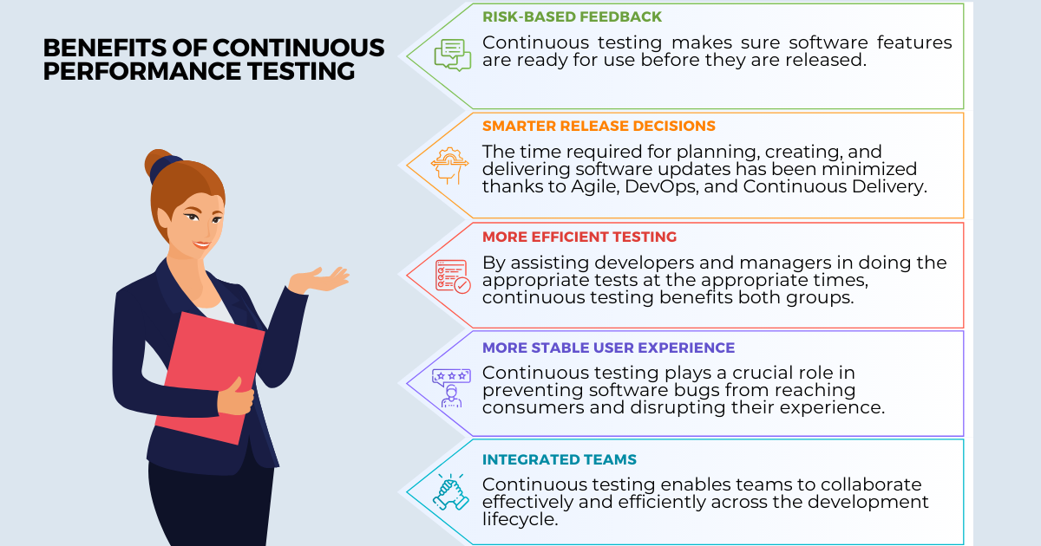
Performance Testing
Benefits of Performance Testing
Validate the fundamental features of the software.
Measure the speed, accuracy and stability of software.
Performance testing allows you to keep your users happy.
Identify discrepancies and resolve issues.
Improve optimization and load capability.
Notes:
The progressive phase introduces and tests new functions, uncovering problems in the newly added or modified modules and in their interfaces with the previously integrated modules. The regressive phase concerns the effect of the newly introduced changes on all the previously integrated code. Problems arise when errors made in incorporating new functions affect previously tested functions.
The basic regression testing approach is to incorporate selected test cases into a regression test bucket that is run periodically in an attempt to detect regression problems. Usually the full bucket is run only occasionally, but the subset is run against every spin. The spin subset should include all the test cases for any recently integrated functions and a selected sample from the full regression bucket.

Slide 27
What is Test Planning?
Define the functions, roles and methods for all test phases.
Test planning usually start during the requirements phase.
Major test plan elements are:
Objectives for each test phase
Schedules and responsibilities for each test activity
Availability of tools, facilities and test libraries.
Set the criteria for test completion
Notes:
Generally speaking, it is too late to begin test planning when testing actually begins. A test planning can uncover at least as many problems as the actual tests themselves.
Test planning starts with an overall development plan that defines the functions, roles and methods for all test phases. Some items needed for a good test plan must come from the requirement phase and they must be tracked throughout development. So, it would be better to conduct an early requirements inspection or walkthrough and to hold a re-review after every major changes.

Slide 28
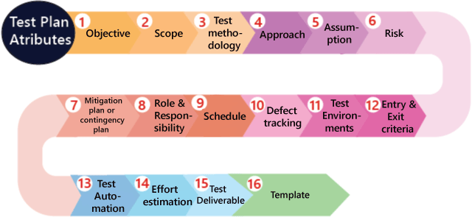
Test Planning

Slide 29
Test Execution & Reporting
Testing should be treated like an experiment.
Testing require that all anomalous behavior be noted and investigated.
Big companies keep a special library with all copies of test reports, incident forms, and test plans
Notes:
Everything test should be treated like an experiment toe be carefully controlled and recorded so that it can be reproduced.
The experimental approach also requires meticulous care in defining and recording the test environment., the procedures,and the test cases. Many organizations have found it valuable to keep a special test library with all copies of such material, together with test reports, incident forms, test analyses, and test plans.

Slide 30
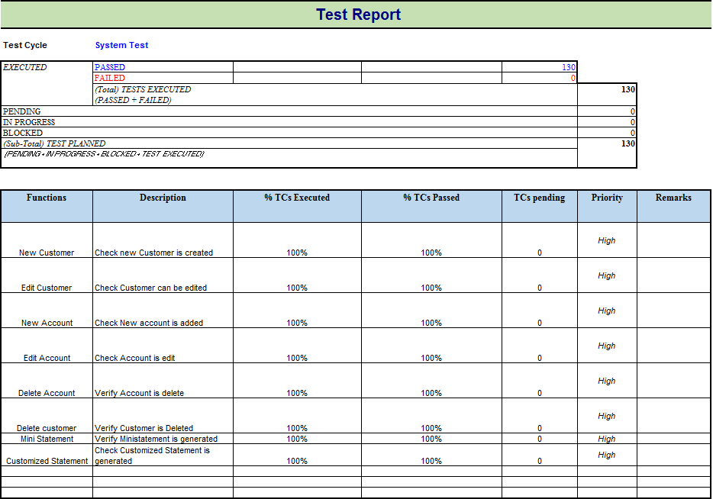
Test Execution & Reporting
Notes:
Everything test should be treated like an experiment toe be carefully controlled and recorded so that it can be reproduced.
The experimental approach also requires meticulous care in defining and recording the test environment., the procedures,and the test cases. Many organizations have found it valuable to keep a special test library with all copies of such material, together with test reports, incident forms, test analyses, and test plans.

Slide 31
Real-Time Testing
Real-Time testing is necessary because the deployment system is usually more complicate than development system
Rules apply for testing real time system
Evaluate possible deadlocks, thrashing to special timing conditions
Use tests to simulate hardware faults.
Use hardware simulation to stress the software design.
Design ways to simulate modules missing in the development system.
Notes:
Real-time testing can be particularly difficult because the development work is done on a host system and then compiled for execution on a target system.Typically a reasonable set of test and debug facilities is available for the host environment but the target system is generally much more sparsely equipped.

Slide 32
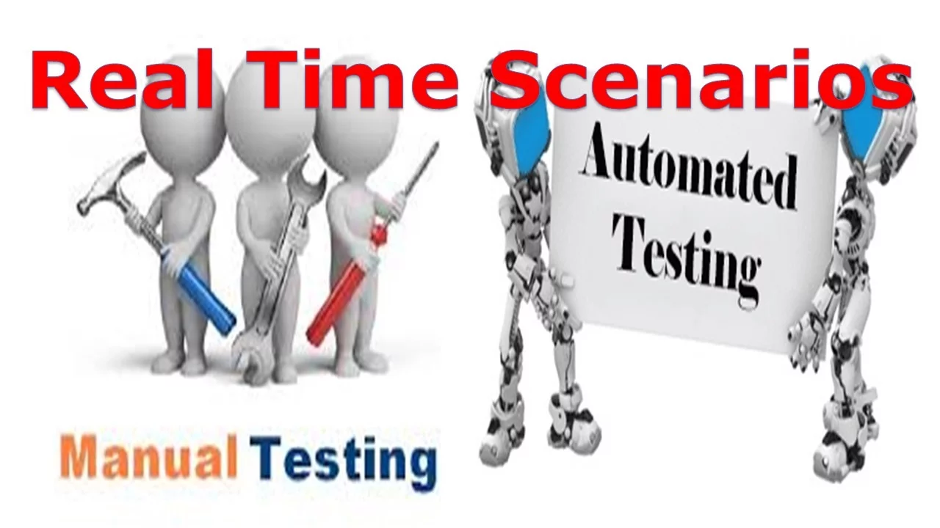
Real-Time Testing
Notes:
Real-time testing can be particularly difficult because the development work is done on a host system and then compiled for execution on a target system.Typically a reasonable set of test and debug facilities is available for the host environment but the target system is generally much more sparsely equipped.

Slide 33
Logical Organization of Testing
( Usually not done in a linear step-by-step order and completed when the last step is reached! )
Component (unit) code
Unit test
White box testing
(by developer)
Black box testing
(by customer)
Tested component
Component (unit) code
Unit test
Integration test
Integrated modules
System test
System in use
Ensures that all components work together
Component (unit) code
Unit test
Function test
Quality test
Acceptance test
Installation test
Ensure that each component works as specified
Verifies that functional requirements are satisfied
Verifies non-functional requirements
Customer verifies all requirements
Testing in user environment (“platform”)

Slide 34
Thank You

